Slide 1
JMS 434
PABEL LOPEZ, CARLA RAUSEO, AMANDA RIVERA & MONSERRAT TORRES

Slide 2
San Diego’s STD rate is higher than the national average
"Sexually transmitted diseases are a silent, national epidemic," said Dr. Wilma Wooten, the county's public health officer. KPBS City News Service.
STD rates in San Diego are rising, it is important now more than ever for people to get tested. How can we make it easy for individuals to get tested in a more private manner? and how can we help them get treatment?
U.S Center for Disease and Control Prevention = San Diego year-over-year rate increase 7.6%

Slide 3
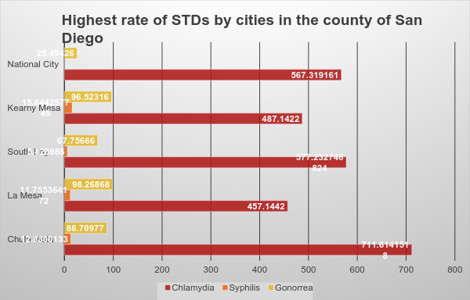
STD rates in San Diego

Slide 4
Databases
Live Well San Diego - www.livewellsd.org -Communicable Diseases
Syphilis
Primary and Secondary Syphilis† Incidence: *Rates per 100,000 population. County age-adjusted rates per 100,000 2000 US standard population.
Chlamydia
Chlamydia† Incidence: *Rates per 100,000 population. County age-adjusted rates per 100,000 2000 US standard population.
Gonorrhea
Gonorrhea Incidence: *Rates per 100,000 population. County age-adjusted rates per 100,000 2000 US standard population.

Slide 5
Shh...TD
What is it?
An app.. that serves to help identify and treat various STDs.
What does it do?
Provides general information about various STD’s and their symptoms.
Get tested!
A person can order a test to take in the comfort of their own home.
Clinicians can recommend regimens or provide medication.
Locate the nearest health clinic to you.
Chat with a clinician! Ask questions anonymously.

Slide 6


